Slide 1
Regulation of Appetite

Slide 2
Learning Objectives
Discriminate between the different biological and psychological impulses to eat.
Explain the differences between energy intake, and energy ingestion and list some factors that may confound the relationship between intake and energy balance.
Describe the source and effects of gastrointestinal, hormonal and metabolic signals that affect appetite.
Consider how hormonal, metabolic and genetic factors may be predictive of feeding habits, and how this could inform individualized approaches.
Apply these biological mechanisms to predict how appetite suppressant drugs function.
Explain the relationships between energy expenditure and energy intake, including the timing of this relationship
Apply your knowledge of hunger hormones to explain the role of appetitive drive after a weight loss program, and how this affects sustained weight loss.

Slide 3
What affects our energy intake?
Nutritional needs
Energy needs
Empty Stomach
Social factors
Stress
Pleasure
Genetics
Taste
Digestion
Notes:
21-45% of macronutrient intake is genetic

Slide 4
Genetics Thought Experiment
What aspects of appetite do you think are
Non-familial
Familial, non-genetic (V_{e})
Genetic (V_{g})
How much of total energy intake do you think is explained by genetics (V_{g})?
<20%
20-40%
40-60%
>60%
Notes:
21-45% of macronutrient intake is genetic

Slide 5
Assessing Energy Intake
Several methods of assessing energy intake
Observational
Diet Recall Surveys
Food Frequency Questionnaires
More on this in the Discussion section this week!

Slide 6
The gut microbiome and energy intake

Slide 7
Can the gut microbiome modify energy extraction?
Ridaura VK, Faith JJ, Rey FE, Cheng J, Duncan AE, Kau AL, Griffin NW, Lombard V, Henrissat B, Bain JR, Muehlbauer MJ, Ilkayeva O, Semenkovich CF, et al. Gut Microbiota from Twins Discordant for Obesity Modulate Metabolism in Mice. Science (80- ). 2013; 341: 1241214–1241214. doi: 10.1126/science.1241214.

Slide 8
In terms of energy, is a gram of fat equivalent to a gram of protein?
Yes
No
It depends

Slide 9
In terms of energy, is a calorie of fat equivalent to a calorie of protein?
Yes
No
It depends

Slide 10
Appetite and Energy Intake

Slide 11
Why do we start and stop eating?
Why do we eat
Why do we stop eating
Drive for food
Low blood glucose
Stress
Stomach is full
Rise in gut-derived hormones
Rise in insulin and glucose
~20 minute lag between eating and feeling full

Slide 12
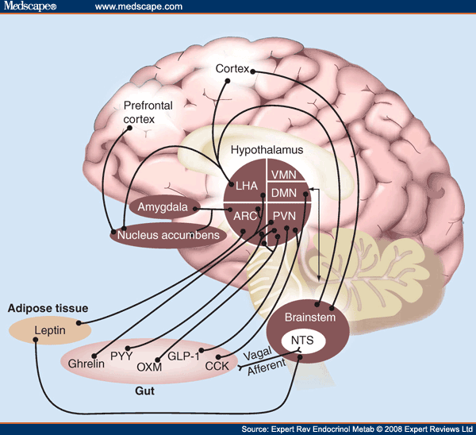
The Central Role of The Hypothalamus

Slide 13
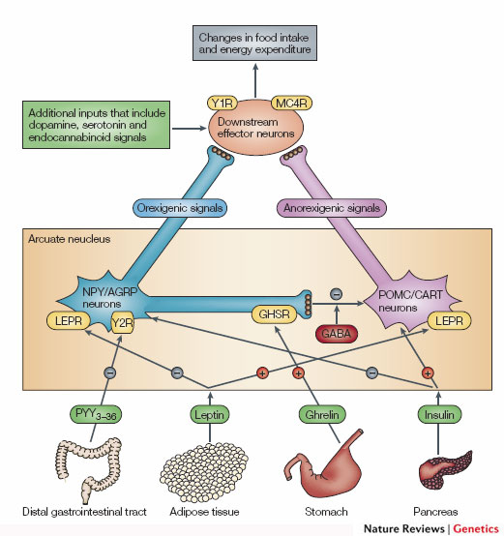
The POMC/AgRP Circuit
Promotes
Eating
Suppresses
Appetite
Notes:
Two populations of neurons in the arcuate nucleus.

Slide 14
Demonstration of AGRP Suppression of Appetite
https://youtu.be/9VolVN3v-YQ

Slide 15
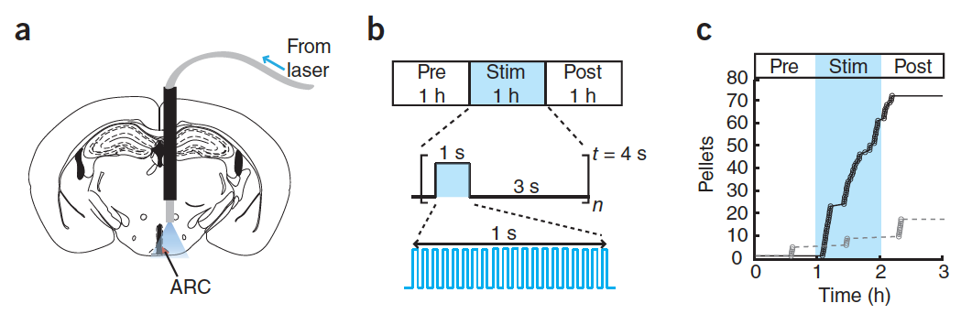
Activation of AGRP Neurons is Sufficient to Promote Hunger
Aponte Y, Atasoy D, Sternson SM. AGRP neurons are sufficient to orchestrate feeding behavior rapidly and without training. Nat Neurosci 2011; 14:351–5.

Slide 16
Neural Control of Appetite (Downstream of AGRP/POMC)
Syndromic obesity variants generally cause over-eating

Slide 17
Stress!!!
Cortisol (a glucocorticoid stress hormone) activates AGRP Neurons
This drives feeding behavior
Adrenaline (a short term stress hormone) also drives appetite

Slide 18
Timed feeding cues
Cortisol awakening response
Sharp rise in cortisol shortly before waking up
May differ between chronotypes
48% genetic
How do you think this would affect feeding behaviors?
Kudielka BM, Federenko IS, Hellhammer DH, Wüst S. Morningness and eveningness: The free cortisol rise after awakening in “early birds” and “night owls.” Biol Psychol. 2006; 72: 141–6. doi: 10.1016/j.biopsycho.2005.08.003.

Slide 19
Why do we stop eating?
The role of our gastrointestinal system
Notes:
~20 minute lag between eating and feeling full

Slide 20
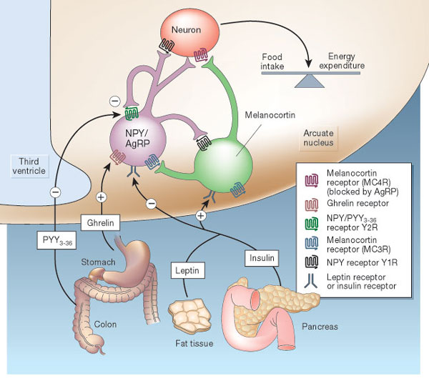
Hormonal Control of Appetite
Notes:
Think about it this way… AgRP neurons like to be on, and when they are on they increase appetite.

Slide 21
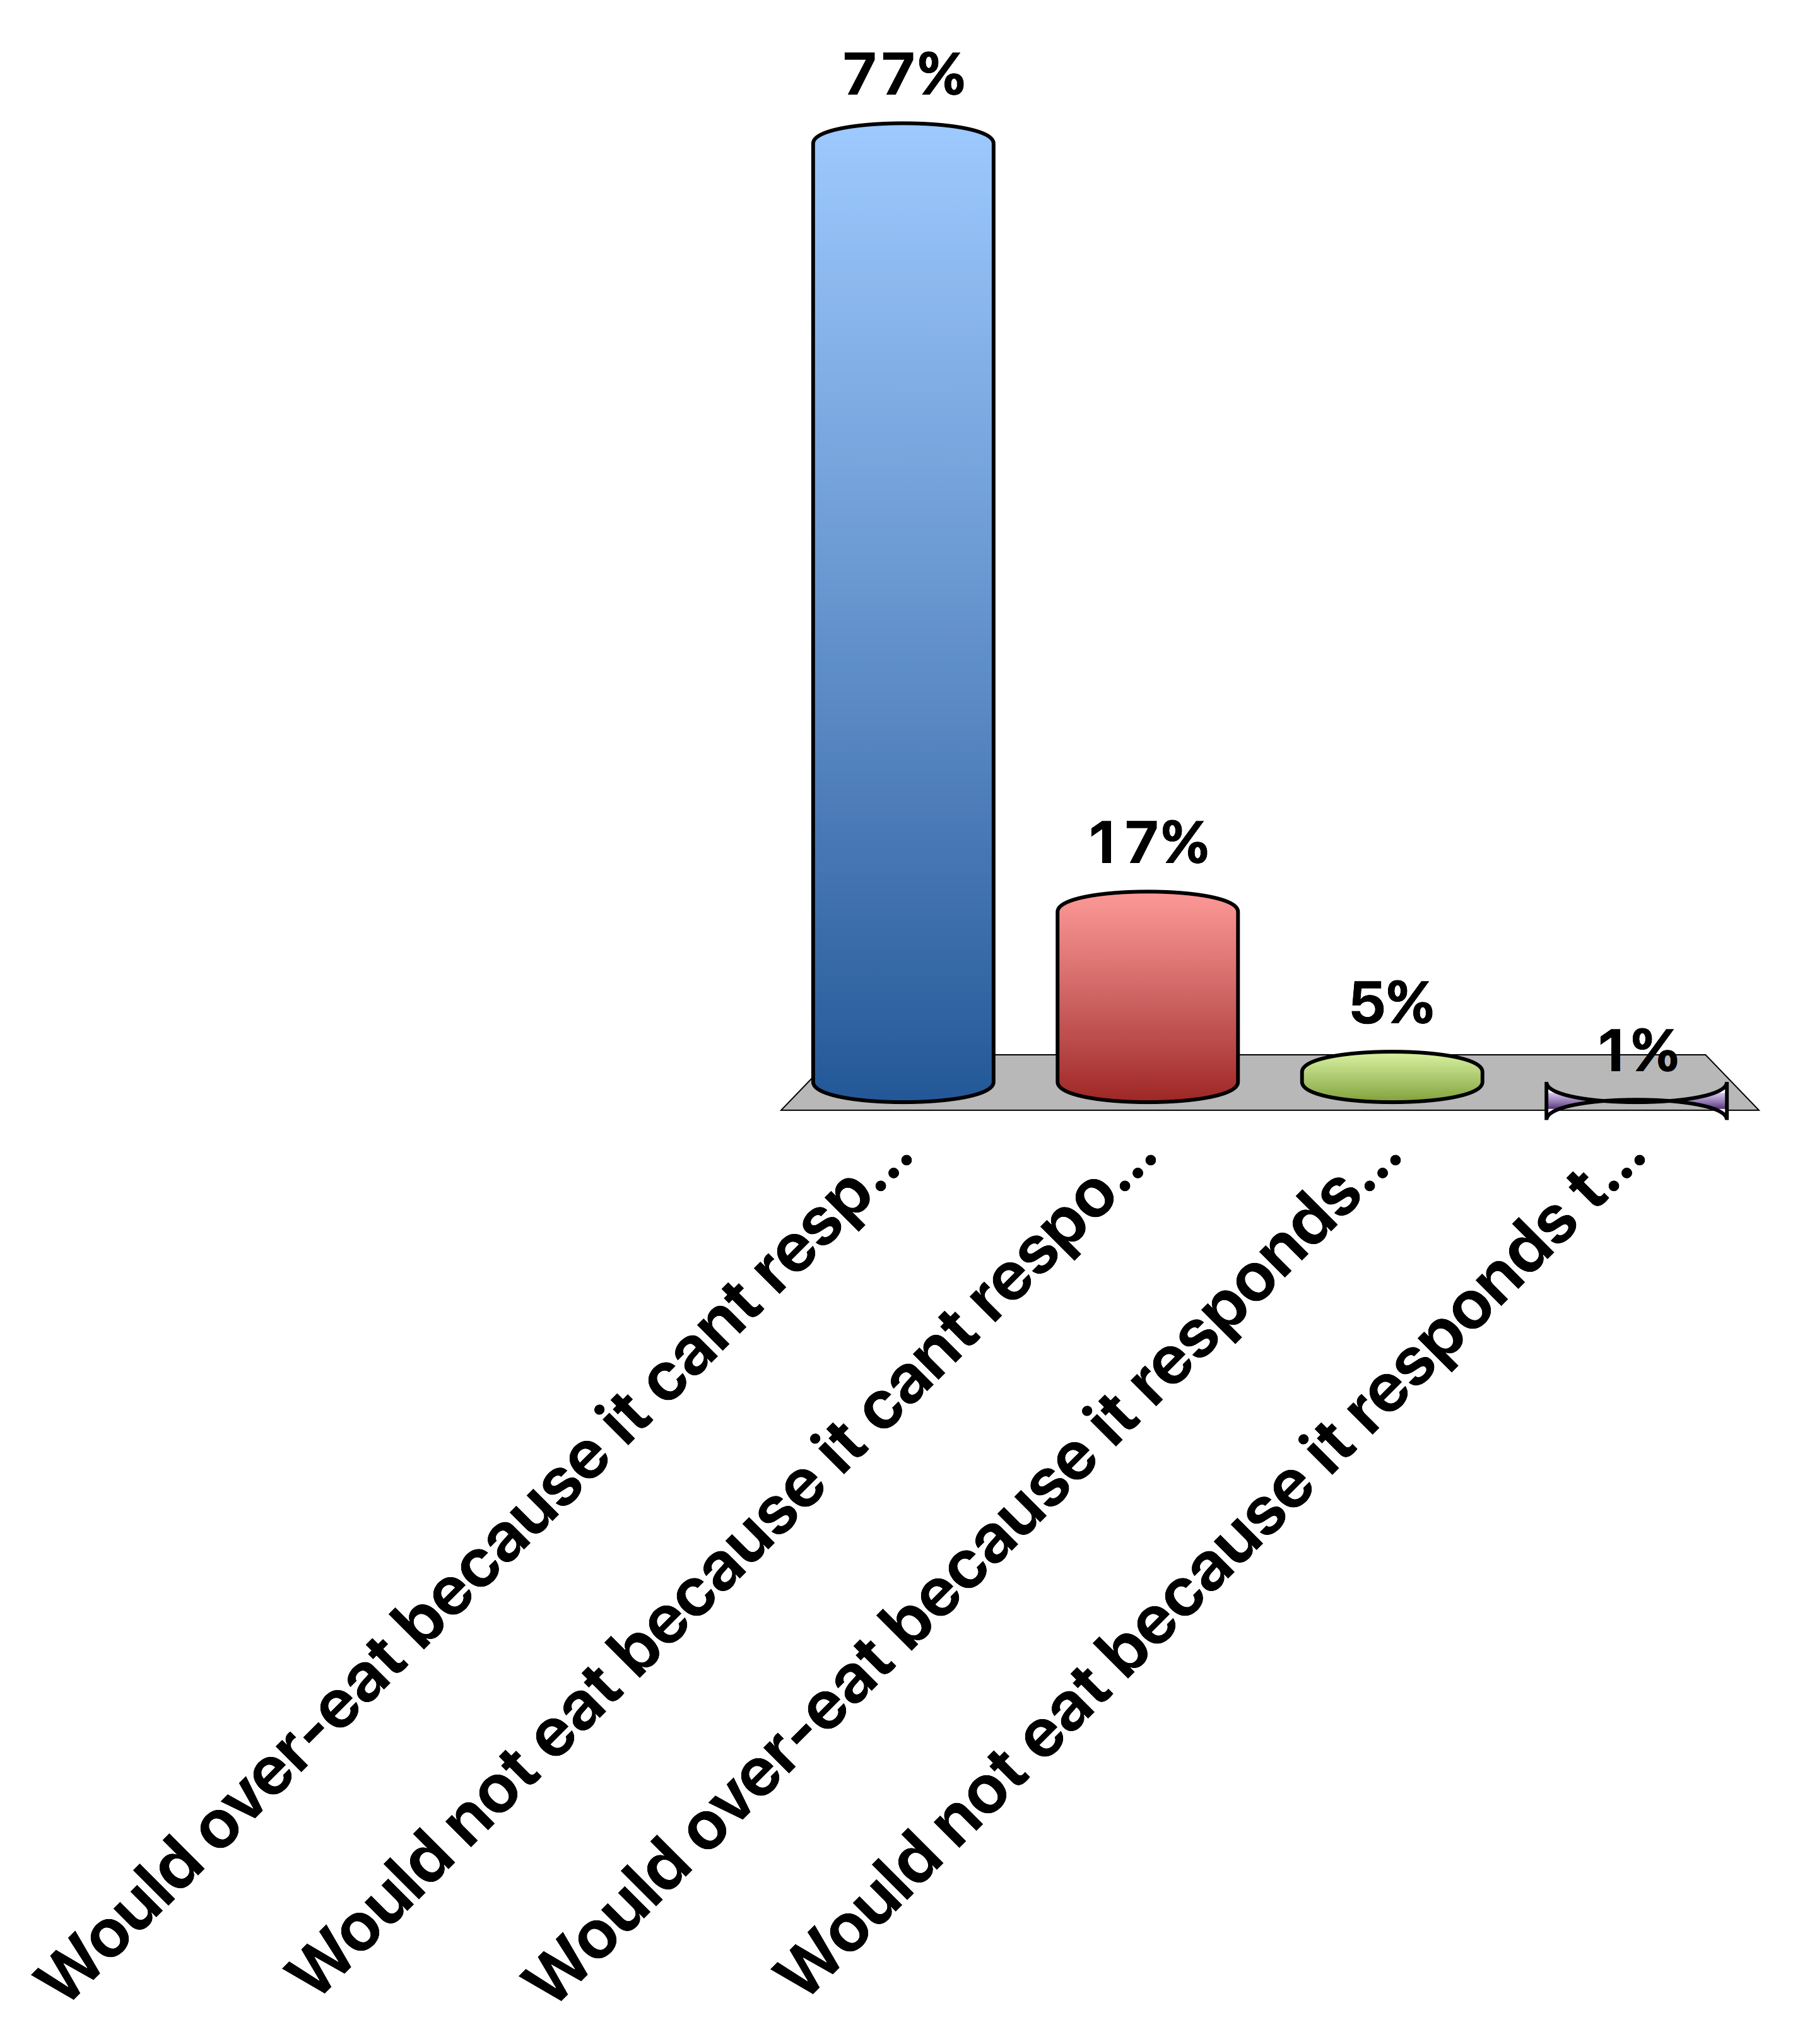
A person with no Leptin Receptor
Would over-eat because it cant respond to leptin
Would not eat because it cant respond to leptin
Would over-eat because it responds too strongly to leptin
Would not eat because it responds too strongly to leptin
0
Notes:
A

Slide 22
Metabolic Signals
Glucose
Signals both at POMC/AgRP and other hindbrain regions to reduce appetitve drive
Insulin
Signals directly at POMC/AgRP circuit to reduce appetitive drive
Proteins and Fats
Potentially suppressive, mechanisms are unclear
Leptin
Related to adipose tissue size

Slide 23
Gastrointestinal Control of Appetite
Notes:
Think about it this way… AgRP neurons like to be on, and when they are on they increase appetite.

Slide 24
Vagal Nerve Signaling
Notes:
Enteric nervous system
Second brain
500 million neurons

Slide 25
Gut Derived Appetite Hormones
Appetite Promoting
Ghrelin
Appetite Suppressing
GLP1
PYY
CCK

Slide 26
Ghrelin, the Hunger Hormone

Slide 27
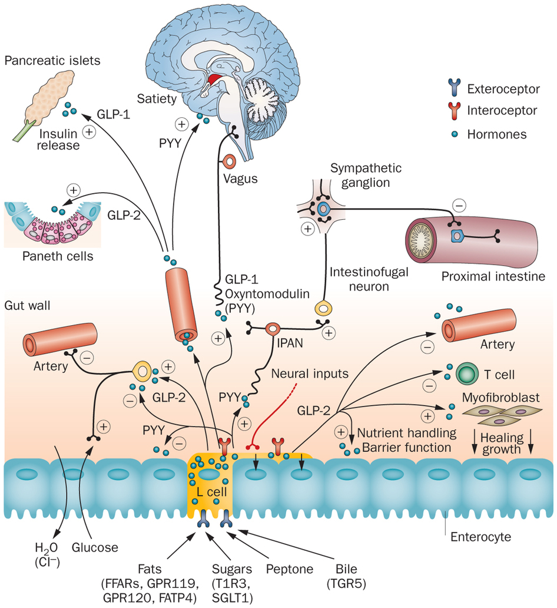
PYY
Secreted from the small intestine

Slide 28
GLP-1 (Glucagon-Like Peptide 1)

Slide 29
GLP-1 Agonists as anti-Obesity Drugs
Liragutide is a GLP-1 analog
Wadden TA, Hollander P, Klein S, Niswender K, Woo V, Hale PM, Aronne L. Weight maintenance and additional weight loss with liraglutide after low-calorie-diet-induced weight loss: The SCALE Maintenance randomized study. Int J Obes. Nature Publishing Group; 2013; 37: 1443–51. doi: 10.1038/ijo.2013.120.

Slide 30
Summary of gut signals
Signal | Effect of food | Effect
Vagal stimulation | Stimulation | Inhibitory
GLP-1 | Secreted by small intestine | Inhibitory
PYY (Peptide YY) | Secreted by small intestine | Inhibitory
CCK | Secreted by small intestine | Inhibitory
Ghrelin | Stomach secretion stops with food | Activating

Slide 31
What is the relationship between intake and expenditure?

Slide 32
Relationship between activity and intake
Over a Day
Over the Week
Edholm OG. Energy balance in man studies carried out by the Division of Human Physiology, National Institute for Medical Research. J Hum Nutr. 1977; 31: 413–31.

Slide 33
Weight loss and appetite

Slide 34
How does weight loss affect appetite hormones
Why does ghrelin go down, but PYY go up with a meal?
Sumithran P, Prendergast LA, Delbridge E, Purcell K, Shulkes A, Kriketos A, Proietto J. Long-Term Persistence of Hormonal Adaptations to Weight Loss. N Engl J Med. 2011; 365: 1597–604. doi: 10.1056/NEJMoa1105816.

Slide 35
How does weight loss affect hunger?

Slide 36
Learning Objectives
Discriminate between the different biological and psychological impulses to eat.
Explain the differences between energy intake, and energy ingestion and list some factors that may confound the relationship between intake and energy balance.
Describe the source and effects of gastrointestinal, hormonal and metabolic signals that affect appetite.
Consider how hormonal, metabolic and genetic factors may be predictive of feeding habits, and how this could inform individualized approaches.
Apply these biological mechanisms to predict how appetite suppressant drugs function.
Explain the relationships between energy expenditure and energy intake, including the timing of this relationship
Apply your knowledge of hunger hormones to explain the role of appetitive drive after a weight loss program, and how this affects sustained weight loss.

